Slide 1

Enriching Word Vectors with Subword Information
2017
Piotr Bojanowski, Edouard Grave, Armand Joulin, and Tomas Mikolov
Group members:
- Nadira Ahmadi
- Hannan Al Hujaily

Slide 2
About the paper
Uses Subword information into word embeddings
Propose a model based on the Subword Information Skip-gram model.
Subword Information
Character level
unsupervised
n-grams
morphemes
To capture more fine-grained information about the word's structure and meaning.
1

Slide 3
About the paper (Cont.)
Word Embedding or Word Vectors
Continuous, dense vectors and high-dimensional
Capture the semantic and contextual information of words.
Skip-gram model
Contextual relationships between words in a large corpus of text data.
2

Slide 4
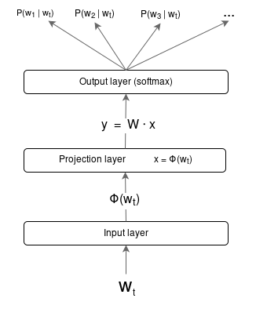
About the paper (Cont.)
Embedding or hidden layer
One-hot encoding vector of target word
3

Slide 5

Related Works
Derived from
Piotr Bojanowski
Lund and Burgess
Mikolov et al.
Co-occurrence Statistics
Log-bilinear Model
Subword Information Skip-gram
1996
2013
2017
2010
2016
Character n-gram Count Vectors
Morphological Information-Distributional Semantics
Wieting et al
Turny, Sak et al.
4

Slide 6

Limitations
Represent each word of the vocabulary by a distinct vector
Ignore the internal structure
Limitation of morphology
5

Slide 7



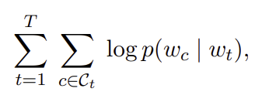


Proposed solution
Proposed model: Learning word representation while taking morphology into account by considering the subword units and representing words by a sum of its character n-grams.
Dictionary size W
Sequence of words from a large training corpus
Set of indices of words surrounding word
6

Slide 8
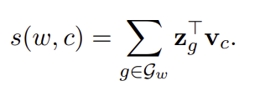



Subword Model
Representing a word by sum of the vector representations of its n-gram.
n=3 grams of the word <where>
Set of n-grams appearing in w
Vector representation to each n-grams g
7

Slide 9
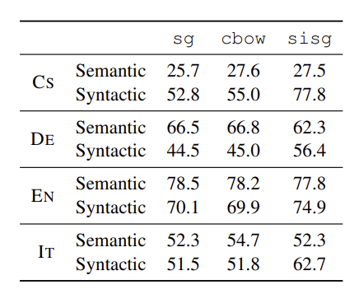
Results
Datasets: They used Wikipedia dumps in 9 languages: Arabic, Czech, German, English, Spanish, French, Italian, Romanian and Russian.
Table 1. Accuracy of the model on word analogy tasks for Czech, German, English and Italian.
8

Slide 10
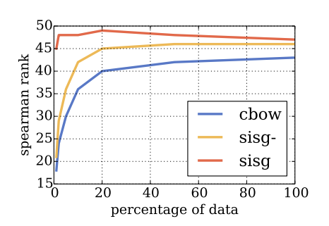
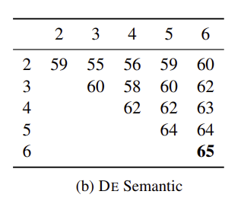
Table 2: Influence of size of the training data on performance.
Table 3: Study of the effect of sizes of n-grams considered on performance.
9

Slide 11
Conclusion
This paper, we investigate a simple method to learn word representations by taking into account subword information. This approach incorporates character n-grams into the skipgram model, because of its simplicity, the model trains fast and does not require any preprocessing.
10

Slide 12
Thank you

